Slide 1
PROBLEM SOLVING AND PROGRAMMING USING PYTHON
Mr.Panduraju Pagidimalla
Assistant Professor, Dept of AIML

Slide 2
Techniques of Problem Solving

Slide 3
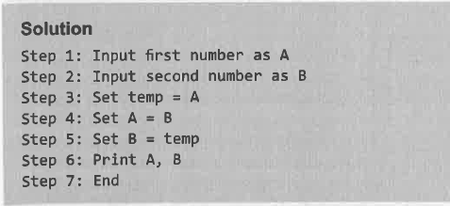
Algorithms and Flowchart
Write an algorithm for interchanging/swapping two values

Slide 4
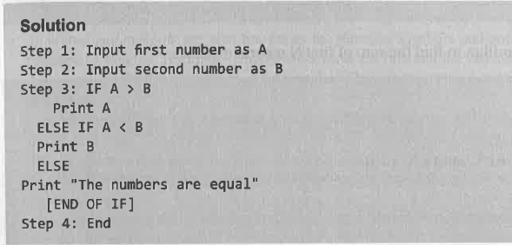
Write an algorithm to find largest of two numbers

Slide 5
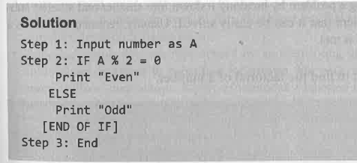
Write an algorithm to find whether a number is even or odd

Slide 6
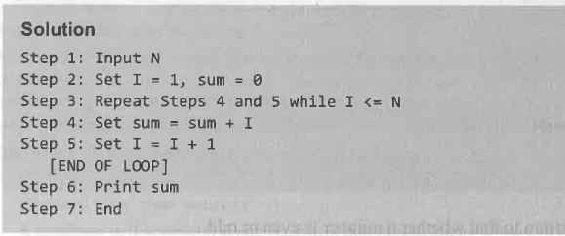
Write an algorithm to find the sum of first N natural numbers

Slide 7
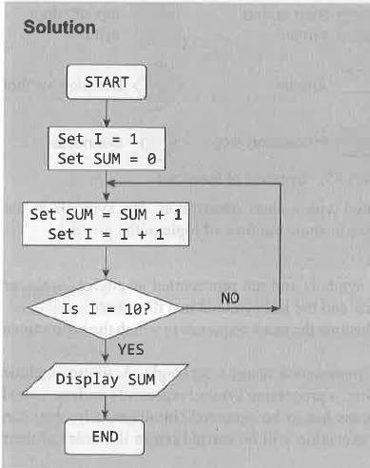
Draw a flowchart to calculate the sum of first 10 natural numbers

Slide 8
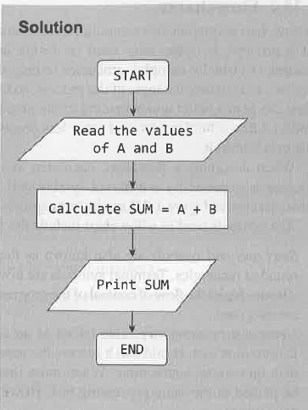
Draw a flowchart to add two numbers

Slide 9
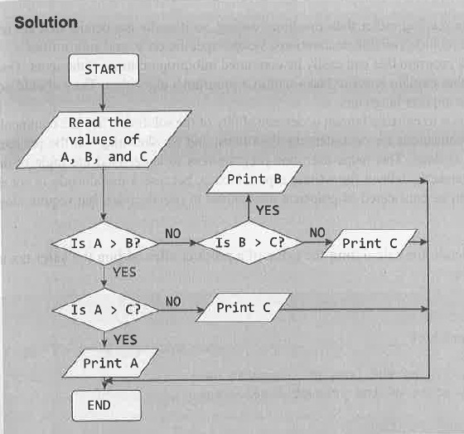
Draw a flowchart to determine the largest of three numbers

Slide 10
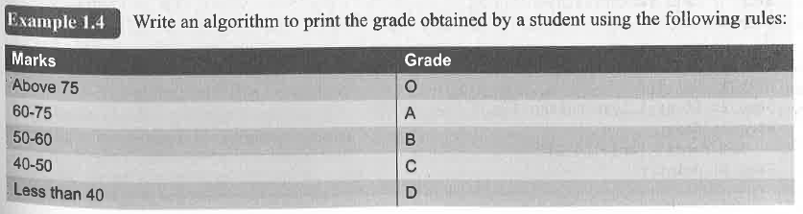

Slide 11
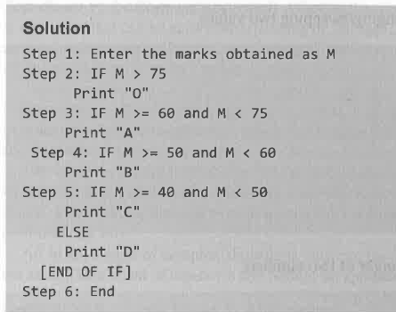

Slide 12
THANK YOU !

